Slide 1
Infomax College of IT & Management
B.Sc.(IT), Second semester.
Module Name: System Analysis and Design
Subject Lecturer: Sir Raghunath Gyanwali
A presentation on:
SAAD Group Assignment

Slide 2
Group Task Report:
Name of the Students | Area of Responsibility
 | Group Component | Individual Component
Sandesh Subedi A (NPI000040) | Operational Feasibility(PIECES) | Interview, Medicine inventory
Rabin Acharya (NPI000035) | Introduction, Functional/Nonfunctional requirements | Prototyping, Patient Registration
Suraj Pandey (NPI000051) | Problems/ proposed solutions of existing system | Document review Appointment
Nabin Chhetri (NPI000032) | Economic Feasibility (Cost benefit analysis), Schedule and technical feasibility. | Observation Generate report
Tej Bahadur Thapa (NPI000054) | Project planning (Gantt Chart, SDLC) | Survey Prescription
Pradip Kunwar (NPI000034) | ERD, Context diagram, lvl 0 DFD | Questionnaire Medicine sales

Slide 3

Introduction to Quantum Software
Quantum Software Co is a company to develop system-based software.
Vision: “To develop platform and productivity services for those who are looking for an affordable solution to their business maintaining what we call The Quality”
Mission: To boost our customer’s business growth by providing creative design and market defining solutions.
Goal: To develop steadily and become a leading player in this competitive global marketplace

Slide 4
Problems & Proposed Solutions
Problems
Loss of data
Difficult to retrieve previously stored data
Time consuming
Redundant data storage
Higher operation cost
Objectives to overcome the problems
To make it easier to maintain the records of patients, doctors, staffs and inventory using DBMS.
To get secured and real-time data collection.
To get accurate medication information within the clinic.
To develop crowd less clinic environment.
Optimize the daily operation expenses
Notes:
Real time data collection: get instant information after collection
Optimize daily expenses: no need for buying stuffs like papers, no need for extra manpower

Slide 5
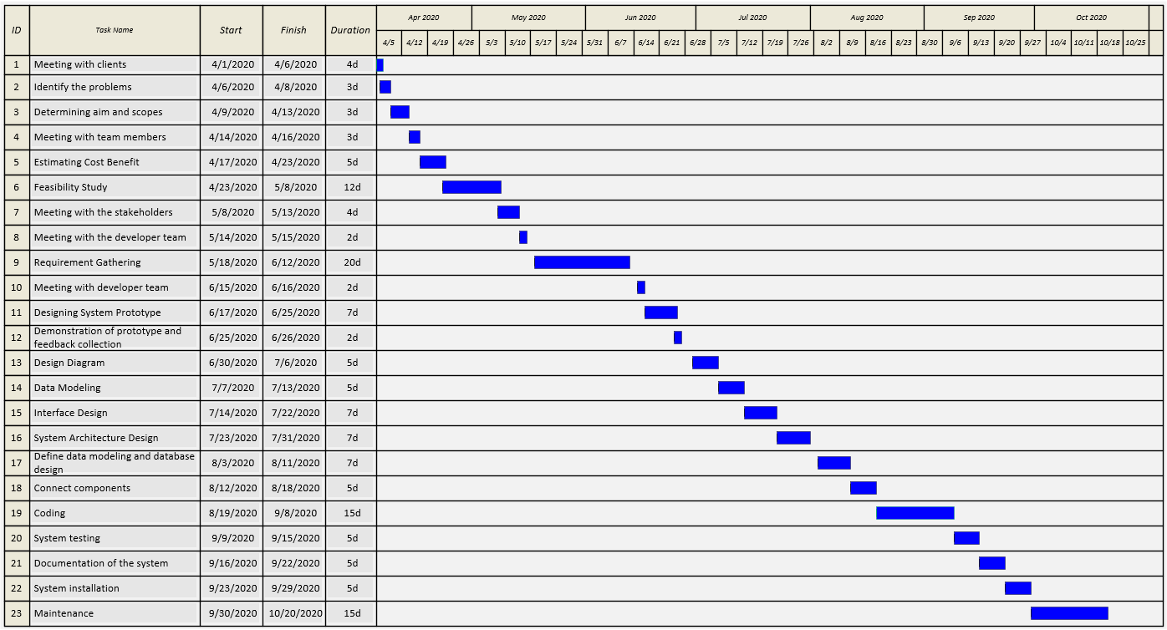
Project Planning

Slide 6
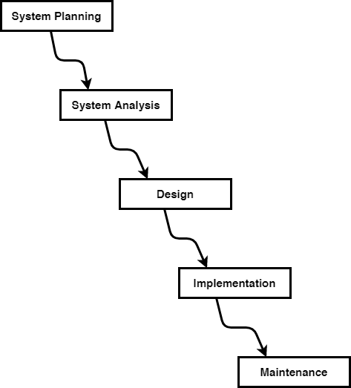
Project Planning
Time analysis
Budget and Manpower calculation
Requirement Gathering (Interview, Prototyping, Document review, Survey, Questionnaire
Coding
Testing
Implementation
Database design
UI design
Fixing bugs
Future enhancements
Notes:
Database design: ERD, Context dia, DFD
UI: Prototype design
Implementation: clients are trained to use the proposed system

Slide 7
Feasibility study
Technical Feasibility
Software, hardware, manpower evaluation
Minimum requirements & recommendation for using the proposed system are:
Minimum Requirements
OS: Windows 10
Processor: 1.6GHz
RAM: 4G RAM
Storage: HDD 256GB
Recommendation
OS: Windows 10 (64-bit)
Processor: 1.8GHz or above (8th gen or above)
RAM: 8GB or above
Storage: 500GB (SSD)

Slide 8
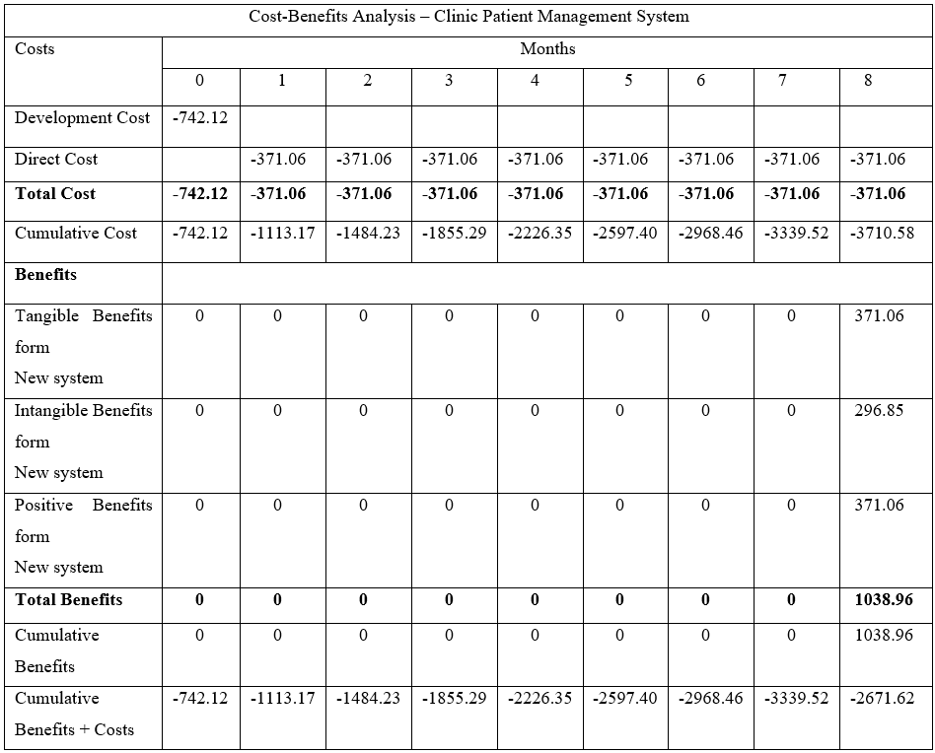
Feasibility study
Economic Feasibility
Made up of technical, market economic and strategic analysis.
Cost Benefit Analysis
Total cost of the system: $3710.58 including development &operational cost.

Slide 9
Feasibility study
Schedule Feasibility
Plan project and process
Finish project before deadline
Gantt Chart

Slide 10
Feasibility study
Operational Feasibility
Does the proposed system fits to the company?
PIECES Framework
Performance:
Poor data management → High throughput
Information:
Input: data redundancy → use of DBMS
Output: Time consuming → instant data access
Stored Data: Unsecured data → data backup

Slide 11
Feasibility study
Operational Feasibility
Economic:
Requires large manpower → minimize manpower
Control:
Open data control → authorized user only
Efficiency:
Slow and unreliable → easy and swift
Service:
Unsatisfactory → satisfactory

Slide 12
Functional requirements/ Non Functional Requirements
Functional Requirements
System should keep patients records (name, address, email, DOB, contact info, medical condition)
Should keep appointment records
Should generate queue management token
Should track visit records of patients/ treatment history
Prescription must be forwarded through the system
Should keep inventory records
Non-functional Requirements
The system should be accessible all time
Should ensure data security
Should have clean UI
Should be compatible to different hardware & OS
Should support future enhancements

Slide 13
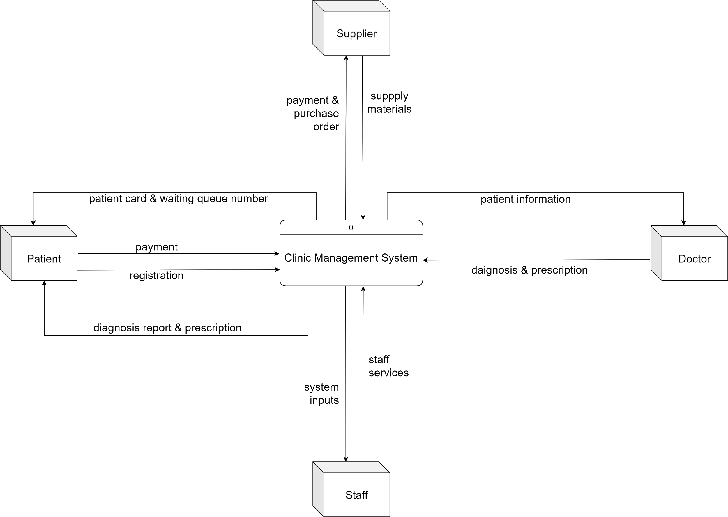
Context diagram
Justification
External entities & their relations
Example: Patient is an external entity, who provides personal details to the system & receive patient card.
Notes:
जेन & Sarson

Slide 14
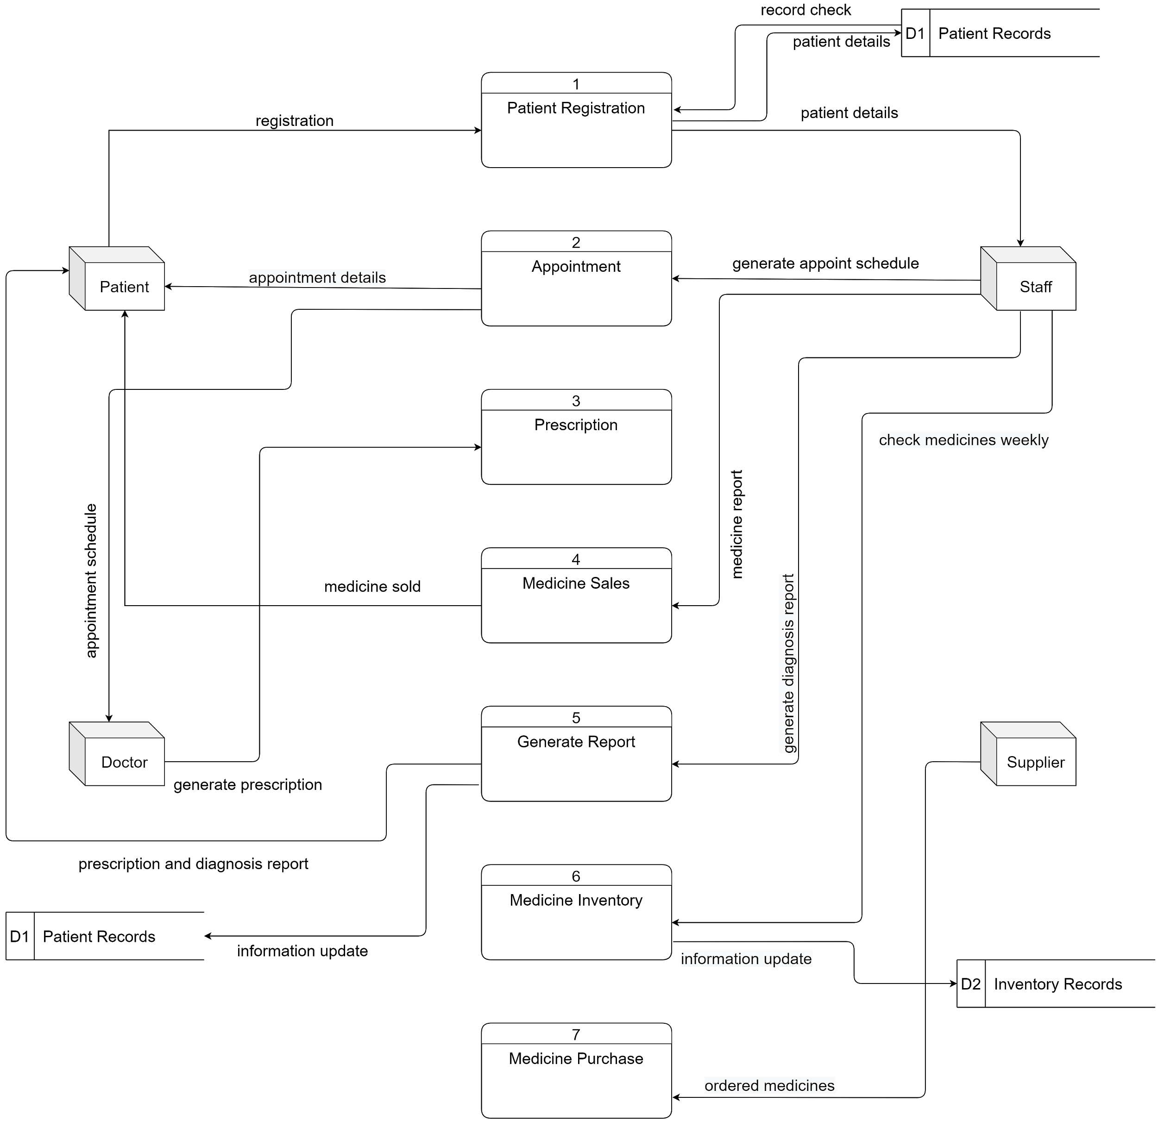
Level-0 DFD diagram
Justification
It is further breakdown of context diagram.
Example: Patient gives registration details to the system, system checks if there is any previous records, and then staff provide appointment details to the patient through system

Slide 15
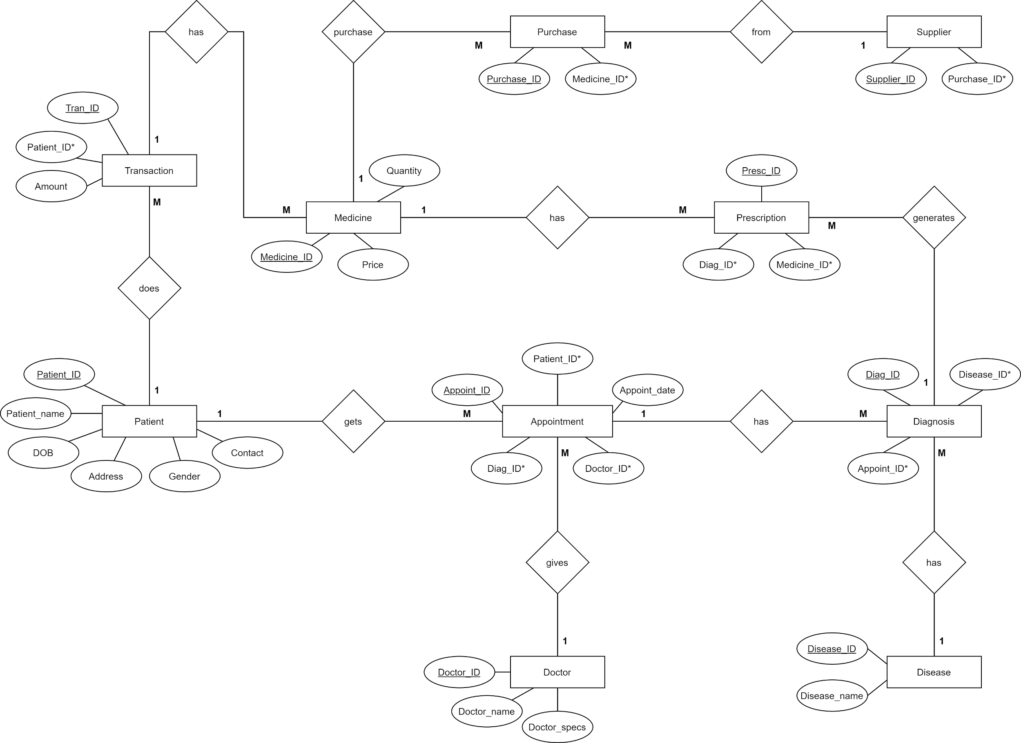
ERD

Slide 16
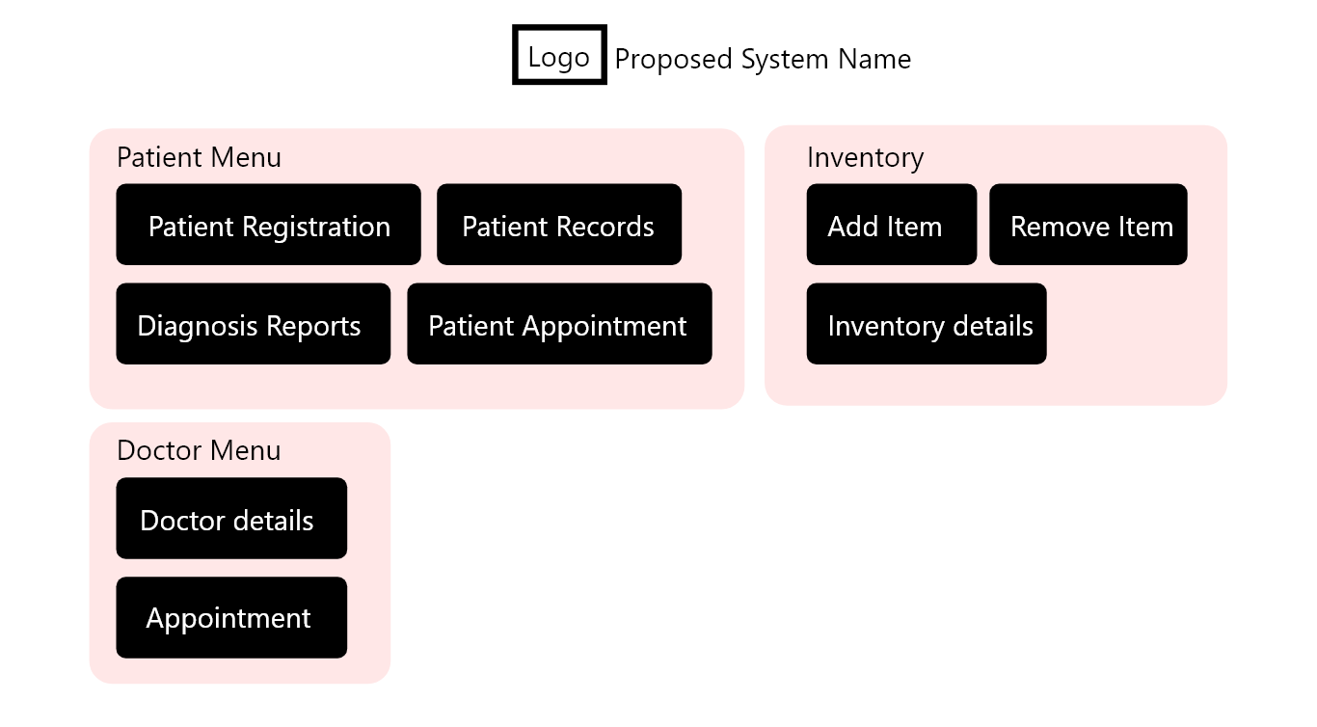
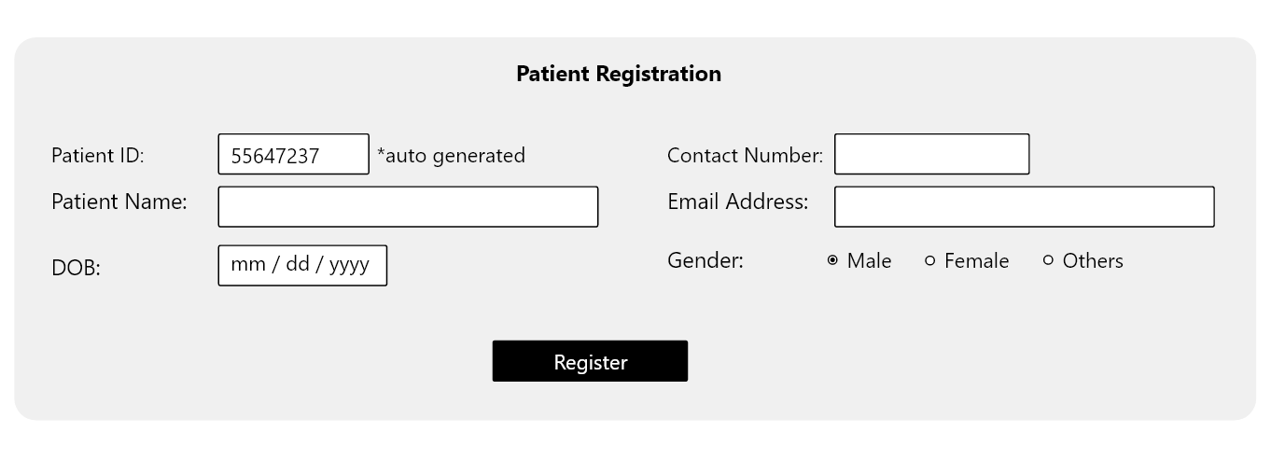
Interface Design
Justification
System avoids collection of unnecessary user data.
Short labeling of inputs/outputs.

Slide 17
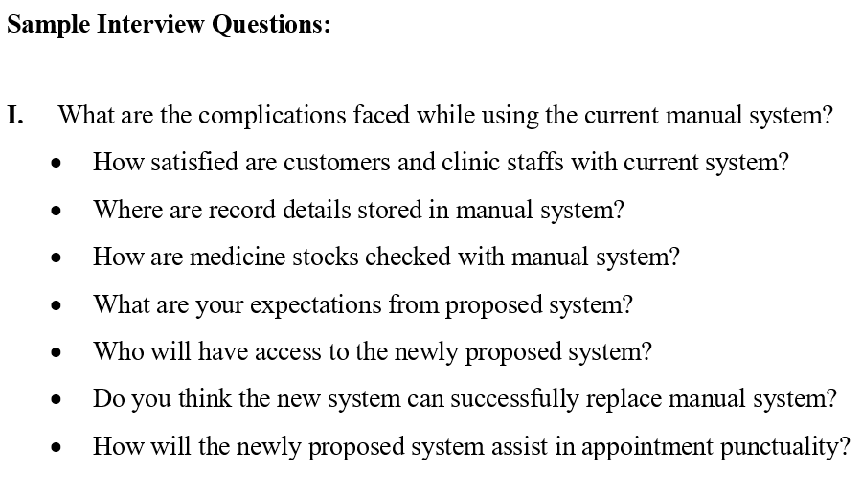
Requirement Gathering (Traditional)
Sandesh Subedi: Interview
Benefits:
Helpful in assembling notable amount of informations
Confusion between participants can be cleared straight away.
Interactive interview cans can produce functional results.
Face to face conversations assists interview to analyze additional info (non verbal behaviors/reaction)
Drawbacks:
Time consumption
Less felxible

Slide 18
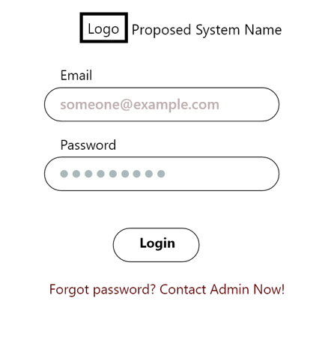
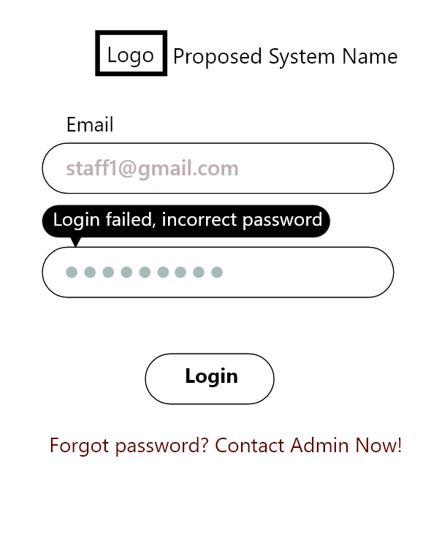
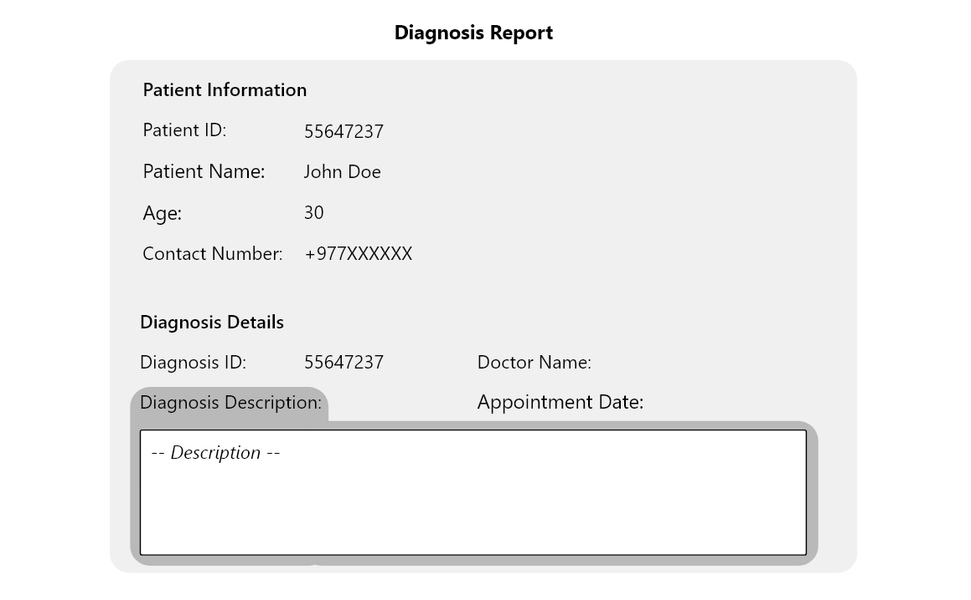
Requirement Gathering (Traditional)
Rabin Acharya: Prototyping
Benefits:
Flexible
Easy error detection
Can be reused for future
User participation ensures grater user satisfaction
Drawbacks:
Costly
Repetitive review may cause great variation in requirements.
Lots of homework for system designers to draft multiple prototype

Slide 19
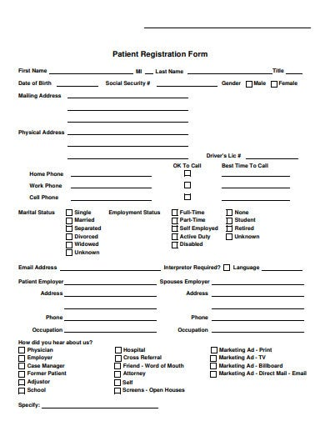
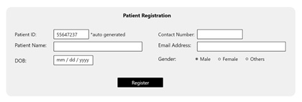
Requirement Gathering (Traditional)
Suraj Pandey: Document Review
Benefits:
Helps to understand history and operation
Comparatively inexpensive
Helps to answer evaluation queries
Drawbacks:
Information may be inapplicable
Can be time consuming as need to obtain each and every samples and find solutions for them
Existing patient registration form
Proposed system’s patient registration system

Slide 20
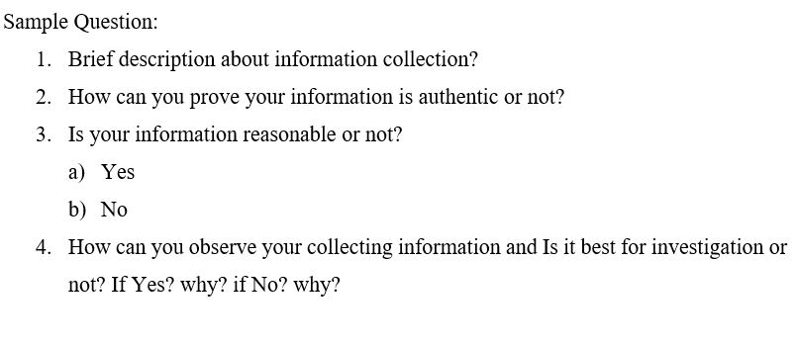
Requirement Gathering (Traditional)
Nabin Chhetri: Observation
Benefits:
It lets system analyst to measure performance
Collects data about experimentation, survey, research or document study
Describes object collected data by occurring natural settings
Drawbacks:
May affect the data while handling other variables of extraneous
Creates difficult to research & collect information
Keeping sample size at a minimum for conducting in-defth studies with data which are difficult to quantify

Slide 21
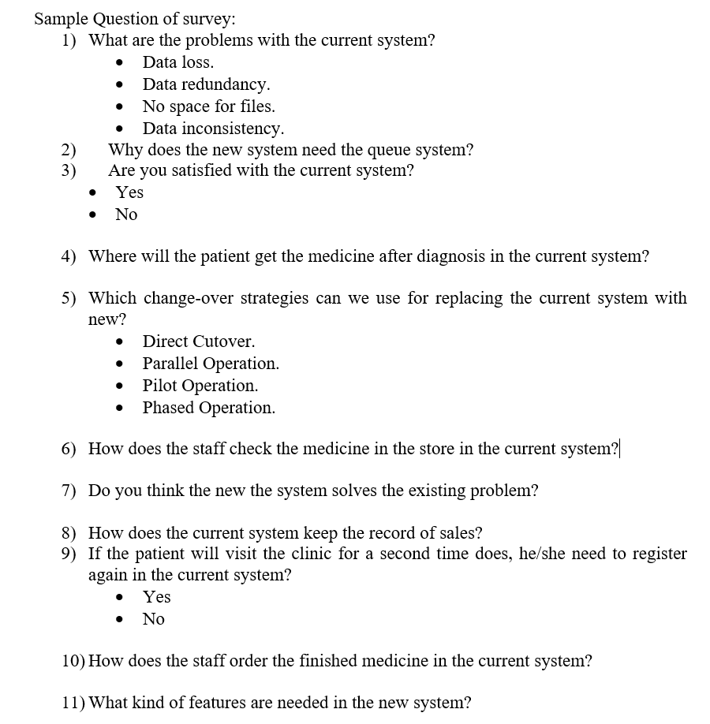
Requirement Gathering (Traditional)
Tej Bahadur Thapa: Survey
Benefits:
Cost effective than interview
Fast data collection
Questionnaires cant cover complex topic but survey can
Multiple form of questions like questionnaires, open-ended, quizzes, MCQs
Drawbacks:
More expensive than questionnairres.
Respondents may provide inaccurate informations

Slide 22
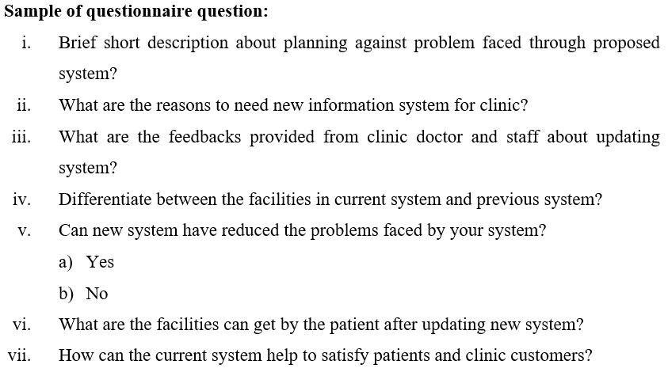
Requirement Gathering (Traditional)
Pradip Kunwar: Questionnaire
Benefits:
Can collect information from remote respondents
Simple to design, develop and administer.
It puts less pressure on respondents
It guarantees the privacy of respondents.
Drawbacks:
Respondents may ignore the questions
Respondents may not understand the questions
Only specific questions are suitable because open ended questions generate flood of data

Slide 23
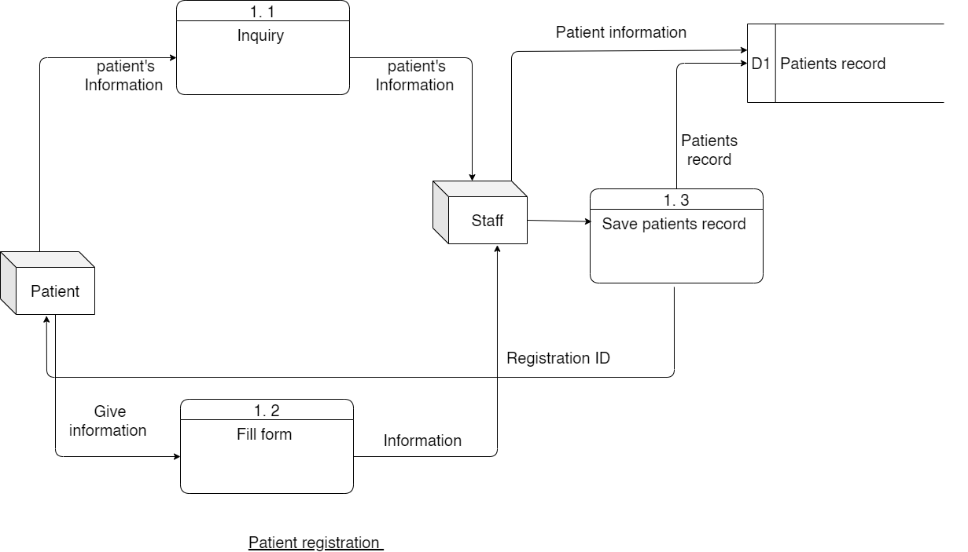
DFD Level 1
Rabin Acharya: Patient Regestration

Slide 24
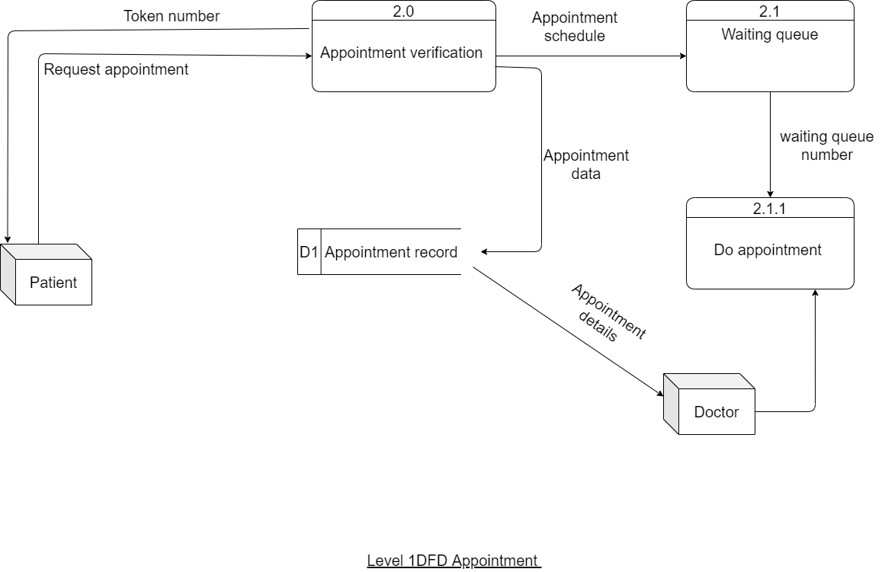
DFD Level 1
Suraj Pandey: Appointment

Slide 25
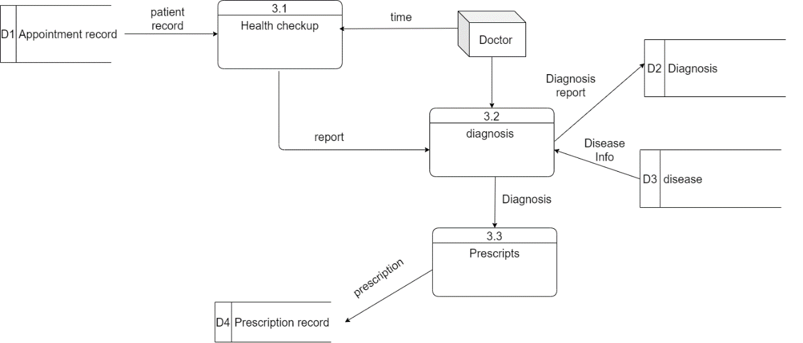
DFD Level 1
Tej Bhadur Thapa: Prescription

Slide 26
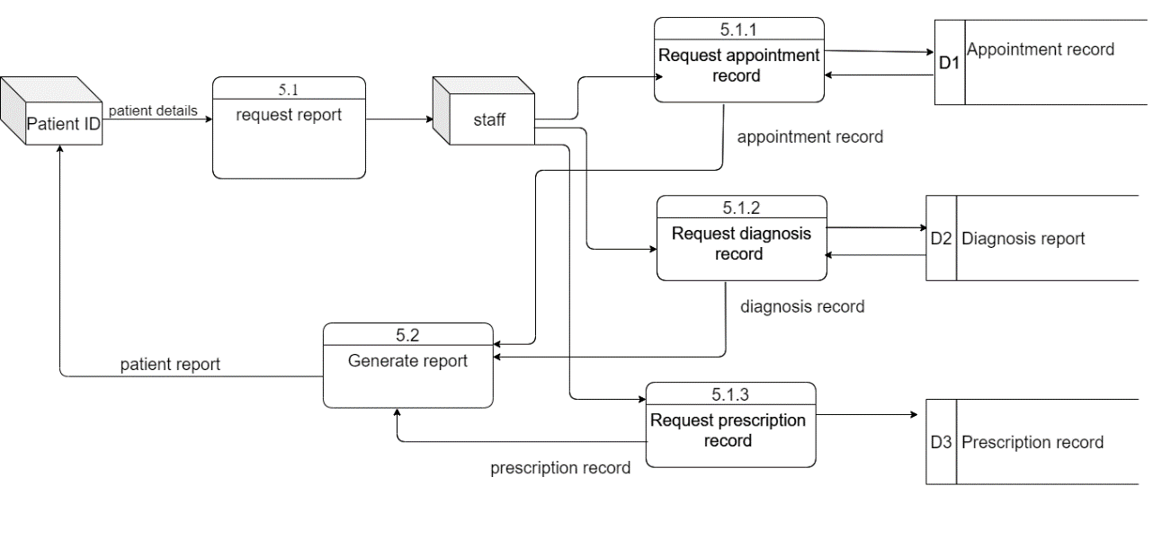
DFD Level 1
Nabin Chhetri: Generate report

Slide 27
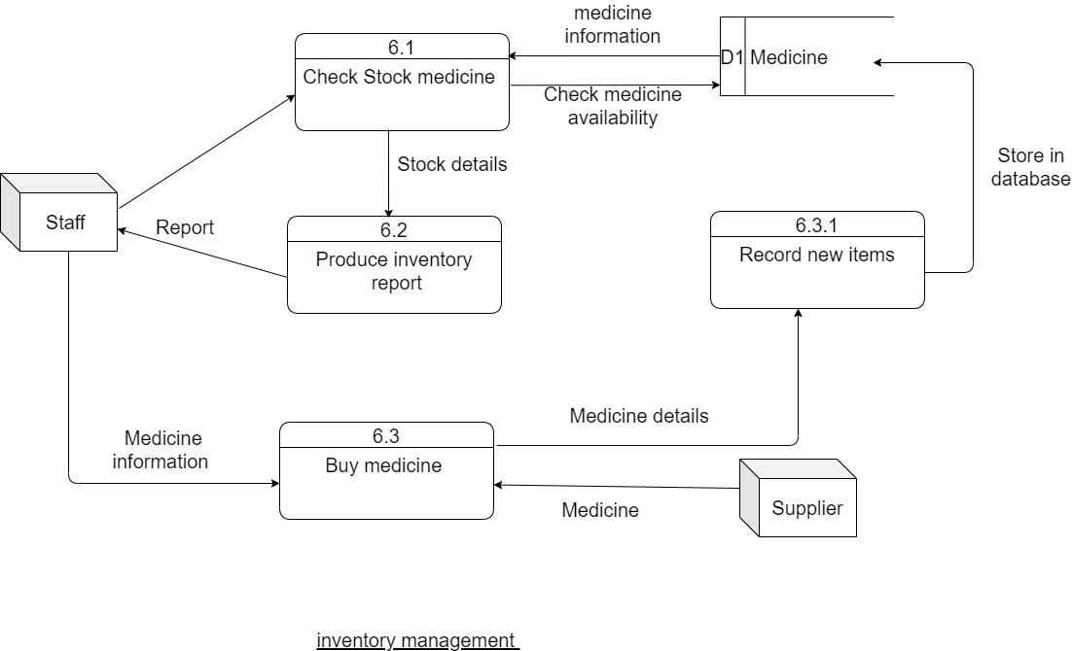
DFD Level 1
Sandesh Subedi A: Medicine Inventory

Slide 28
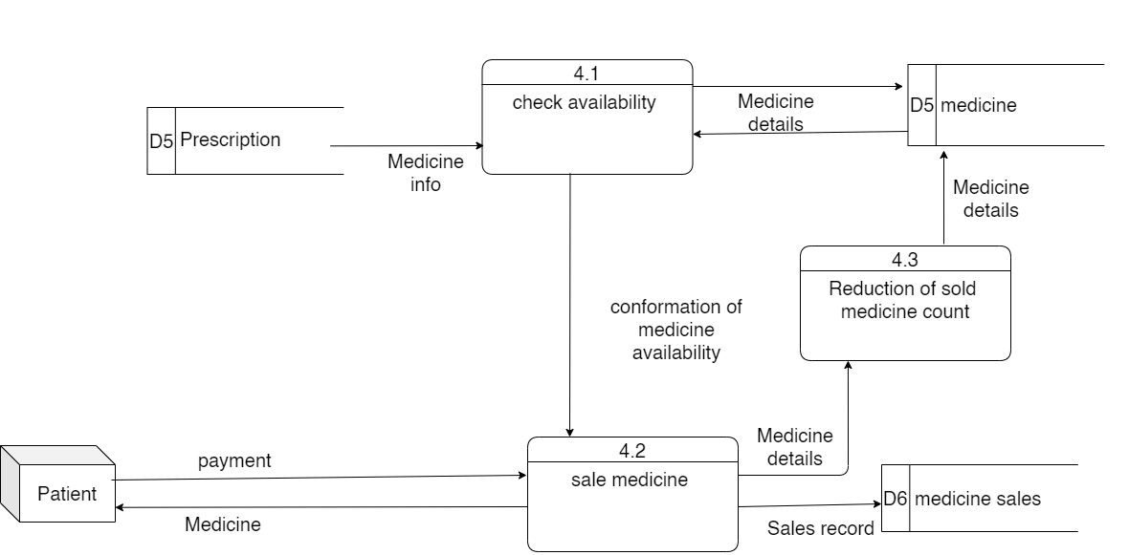
DFD Level 1
Pradip Kunwar: Medicine Sales

Slide 29
Q&A

